Slide 1
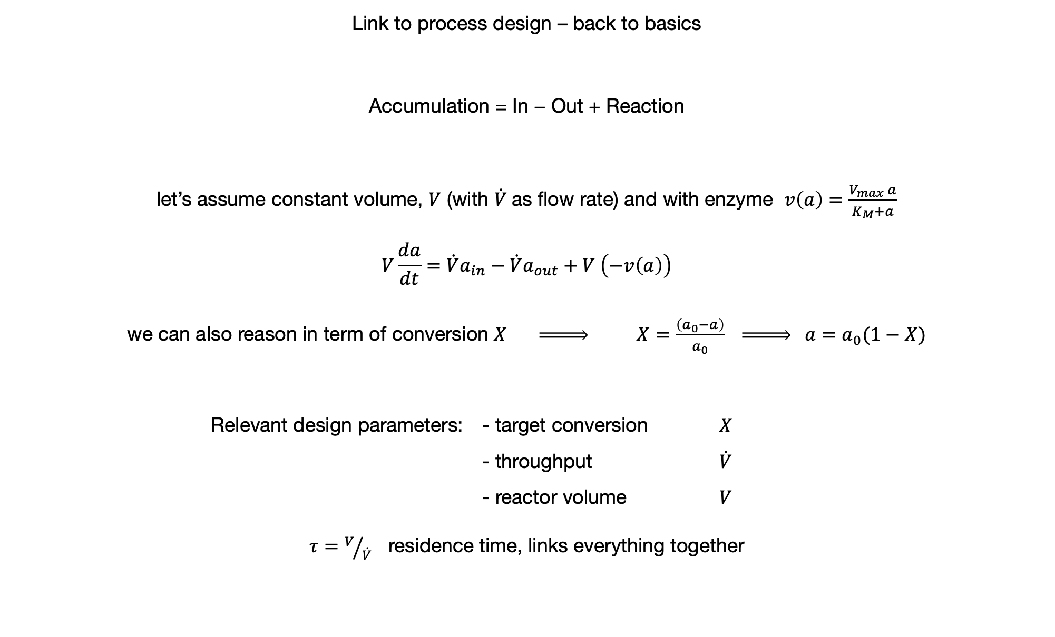
Link to process design – back to basics
Accumulation = In − Out + Reaction
let’s assume constant volume, $V$ (with $\dot{V}$as flow rate) and with enzyme $v\left(a\right)=\frac{V_{max} a}{K_{M}+a}$
$$V\frac{da}{dt}=\dot{V}a_{in}−\dot{V}a_{out}+V \left(−v\left(a\right)\right)$$
we can also reason in term of conversion $X \underset{⇒}{ } X=\frac{\left(a_{0}−a\right)}{a_{0}} \underset{⇒}{ } a=a_{0}(1−X)$
Relevant design parameters: - target conversion $X$ - throughput $\dot{V}$ - reactor volume $V$
$τ=V/{\dot{V}}$ residence time, links everything together

Slide 2
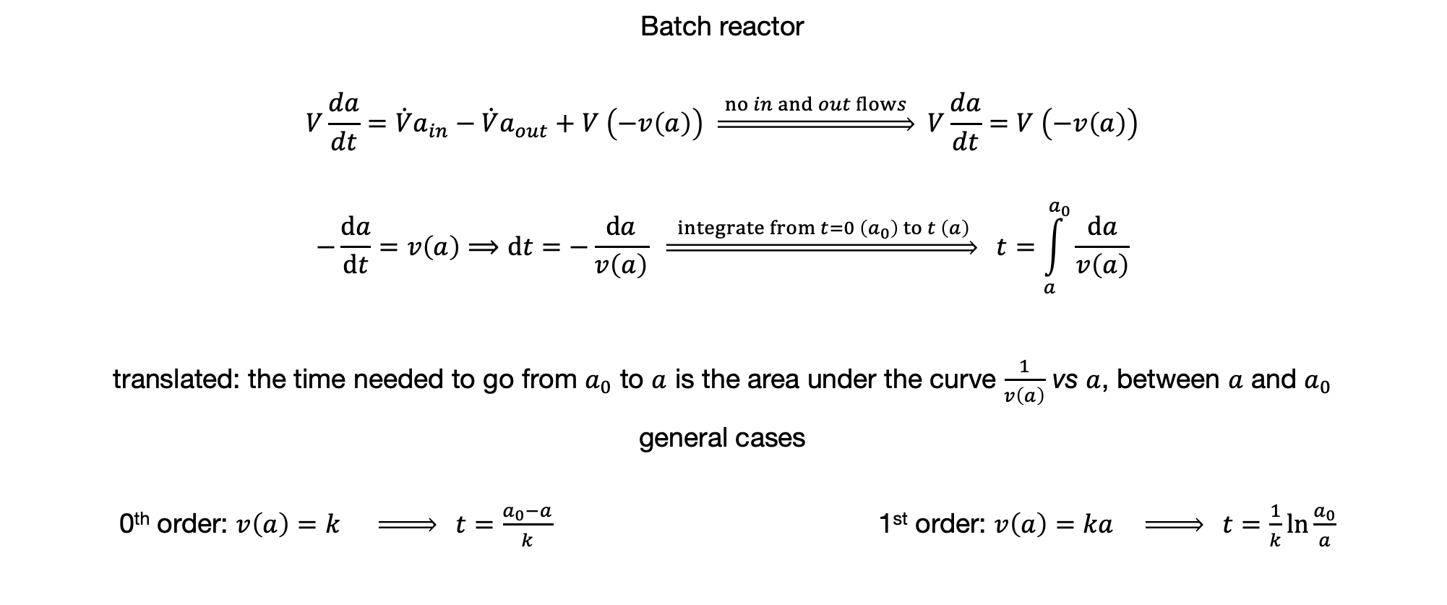
Batch reactor
$$V\frac{da}{dt}=\dot{V}a_{in}−\dot{V}a_{out}+V \left(−v\left(a\right)\right) \underset{⇒}{ no in and out flows } V\frac{da}{dt}=V \left(−v\left(a\right)\right)$$
$$−\frac{da}{dt}=v\left(a\right)⟹dt=−\frac{da}{v\left(a\right)} \underset{⇒}{ integrate from t=0 \left(a_{0}\right) to t \left(a\right) } t=\int_{a}^{a_{0}}{\frac{da}{v\left(a\right)}}$$
translated: the time needed to go from $a_{0}$ to $a$ is the area under the curve $\frac{1}{v\left(a\right)}$ vs $a$, between $a$ and $a_{0}$
general cases
0th order: $v\left(a\right)=k \underset{⇒}{ } t=\frac{a_{0}−a}{k}$ 1st order: $v\left(a\right)=ka \underset{⇒}{ } t=\frac{1}{k}\ln{\frac{a_{0}}{a}}$

Slide 3
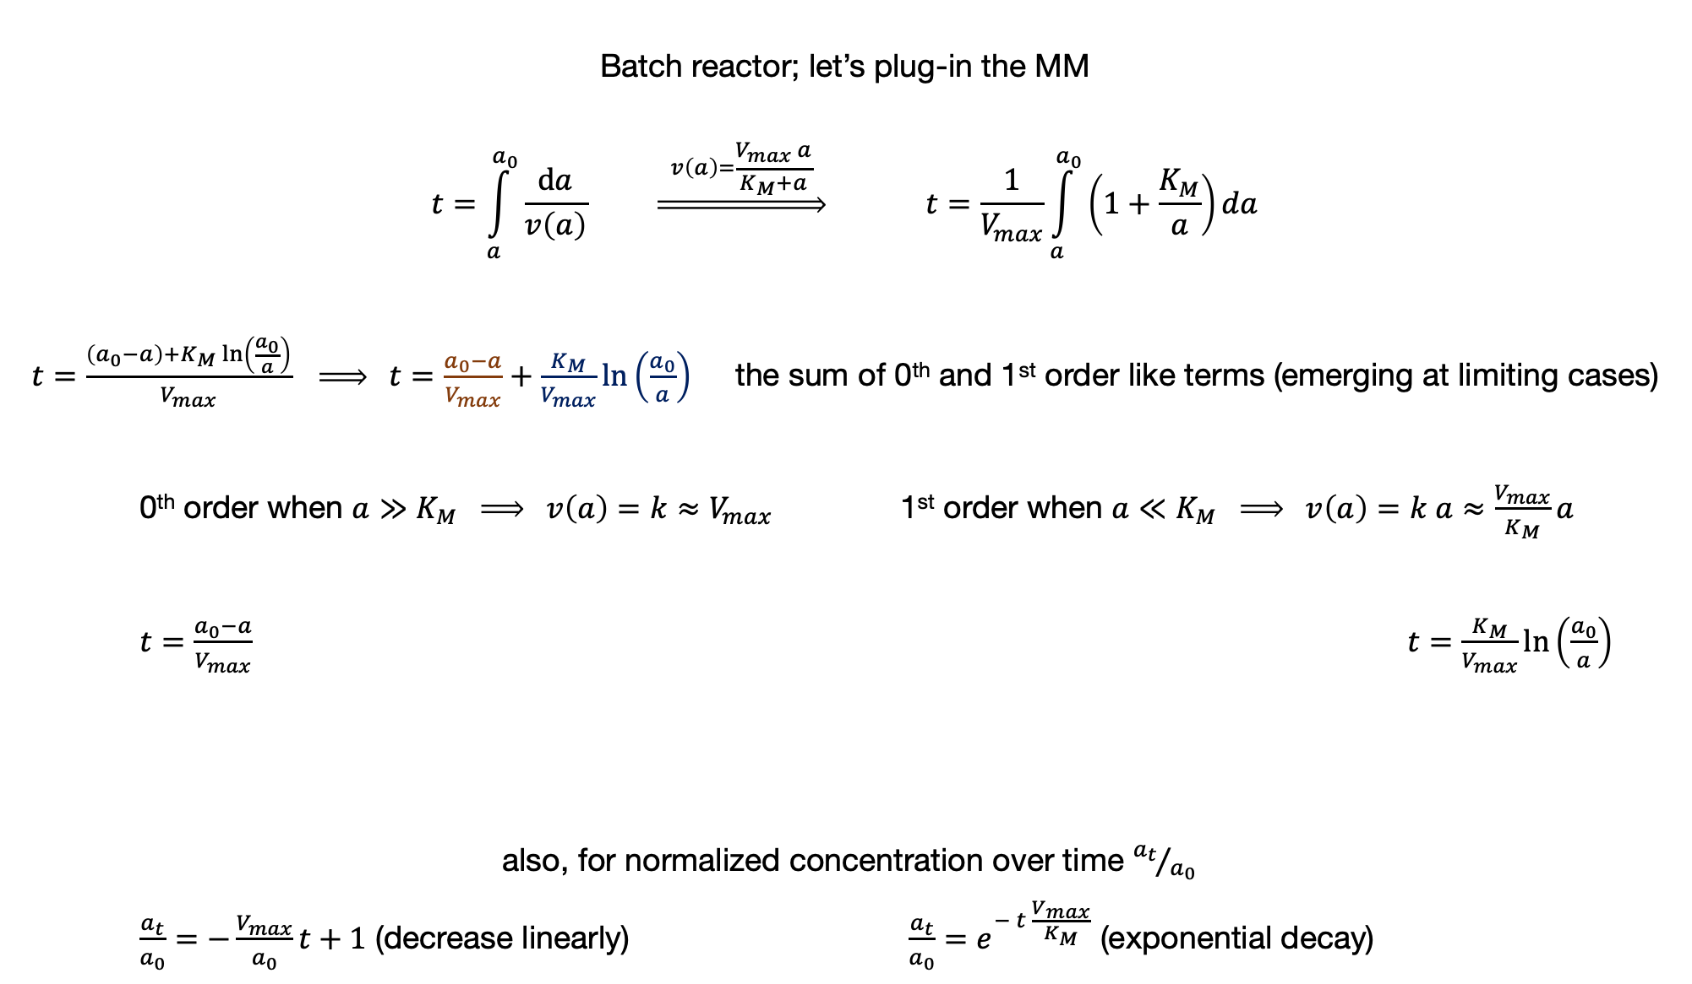
Batch reactor; let’s plug-in the MM
$$t=\int_{a}^{a_{0}}{\frac{da}{v\left(a\right)}} \underset{⇒}{ v\left(a\right)=\frac{V_{max} a}{K_{M}+a} } t=\frac{1}{V_{max}}\int_{a}^{a_{0}}{\left(1+\frac{K_{M}}{a}\right)da}$$
$t=\frac{\left(a_{0}−a\right)+K_{M}\ln\left(\frac{a_{0}}{a}\right)}{V_{max}} \underset{⇒}{ } t=\frac{a_{0}−a}{V_{max}}+\frac{K_{M}}{V_{max}}\ln\left(\frac{a_{0}}{a}\right)$ the sum of 0th and 1st order like terms (emerging at limiting cases)
0th order when $a≫K_{M} \underset{⇒}{ } v\left(a\right)=k≈V_{max}$ 1st order when $a≪K_{M} \underset{⇒}{ } v\left(a\right)=k a≈\frac{V_{max}}{K_{M}}a$
$t=\frac{a_{0}−a}{V_{max}}$ $t=\frac{K_{M}}{V_{max}}\ln\left(\frac{a_{0}}{a}\right)$
also, for normalized concentration over time ${a_{t}}/{a_{0}}$
$\frac{a_{t}}{a_{0}}=−\frac{V_{max}}{a_{0}}t+1$ (decrease linearly) $\frac{a_{t}}{a_{0}}=e^{− t \frac{V_{max}}{K_{M}}}$ (exponential decay)

Slide 4
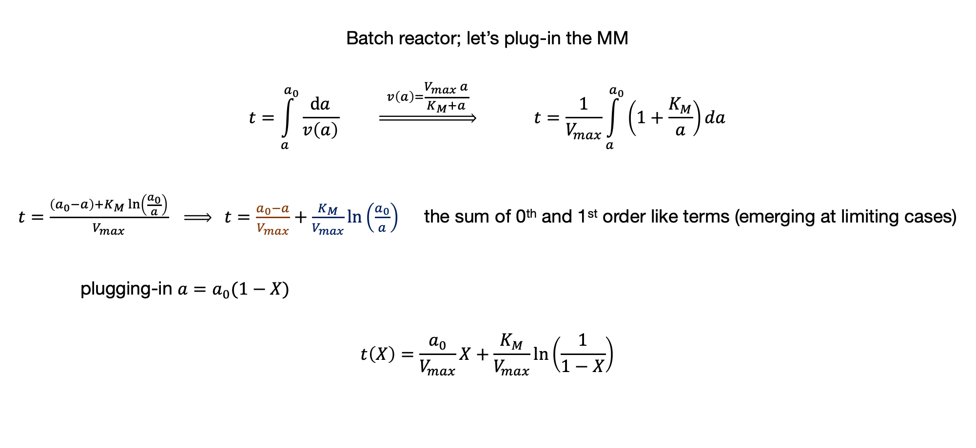
Batch reactor; let’s plug-in the MM
$$t=\int_{a}^{a_{0}}{\frac{da}{v\left(a\right)}} \underset{⇒}{ v\left(a\right)=\frac{V_{max} a}{K_{M}+a} } t=\frac{1}{V_{max}}\int_{a}^{a_{0}}{\left(1+\frac{K_{M}}{a}\right)da}$$
$t=\frac{\left(a_{0}−a\right)+K_{M}\ln\left(\frac{a_{0}}{a}\right)}{V_{max}} \underset{⇒}{ } t=\frac{a_{0}−a}{V_{max}}+\frac{K_{M}}{V_{max}}\ln\left(\frac{a_{0}}{a}\right)$ the sum of 0th and 1st order like terms (emerging at limiting cases)
plugging-in $a=a_{0}(1−X)$
$$t\left(X\right)=\frac{a_{0}}{V_{max}}X+\frac{K_{M}}{V_{max}}\ln\left(\frac{1}{1−X}\right)$$

Slide 5
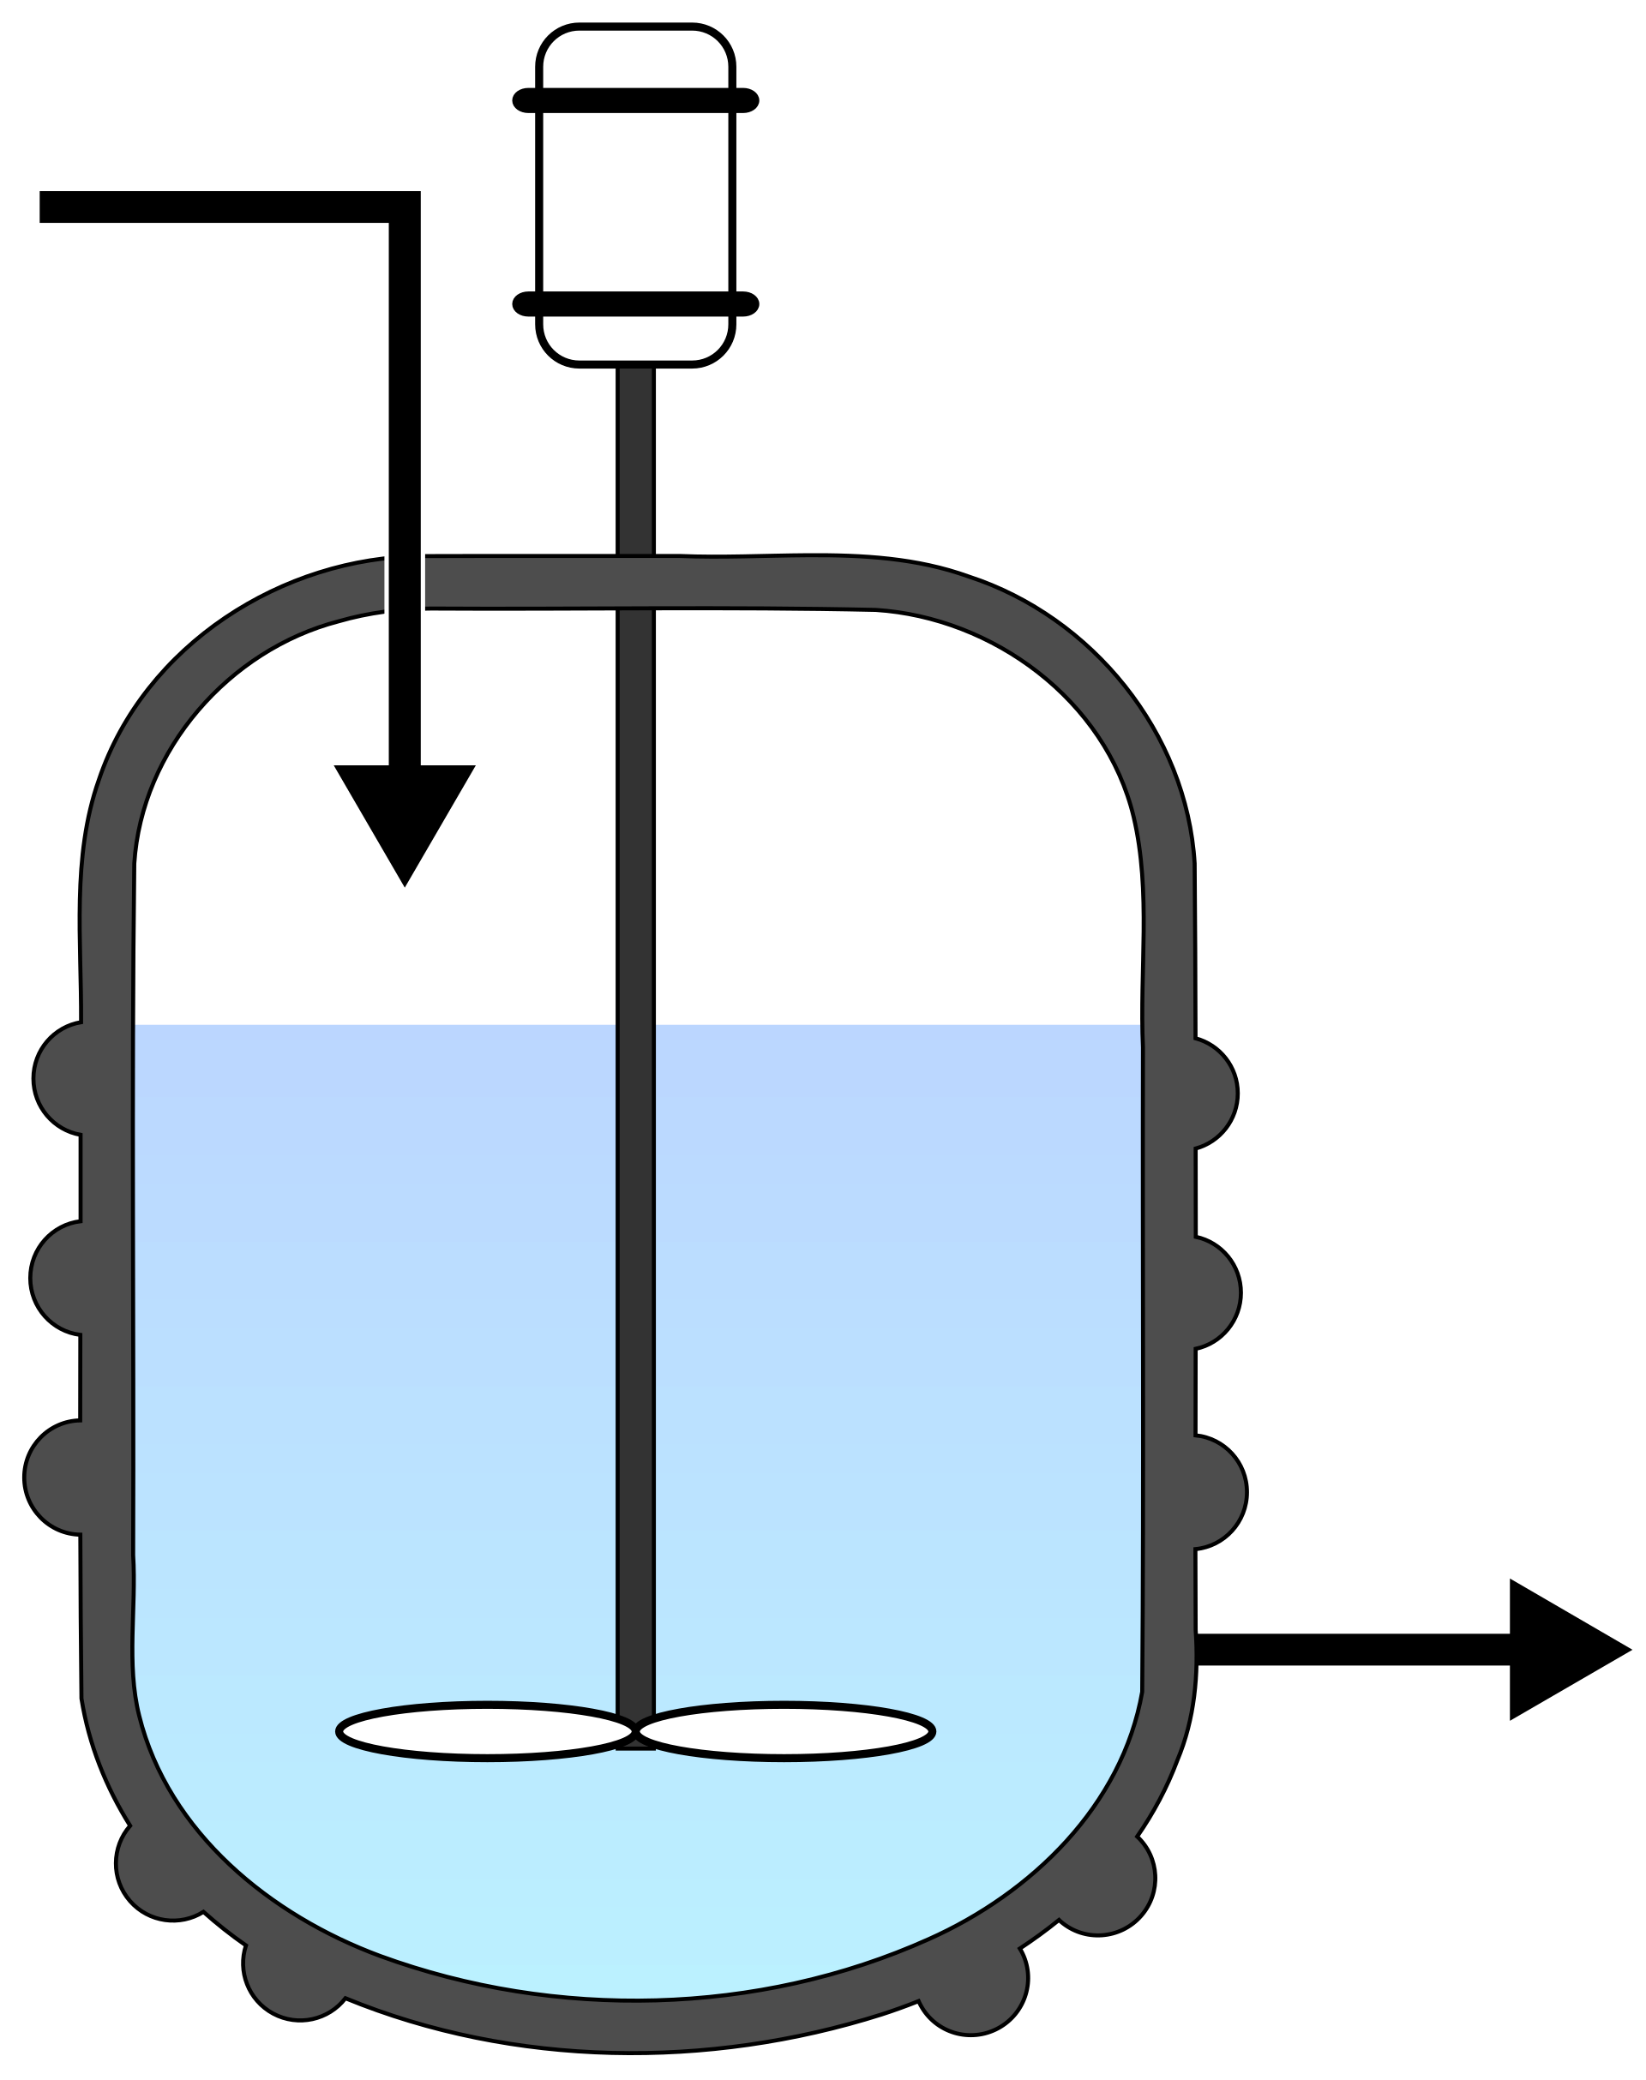
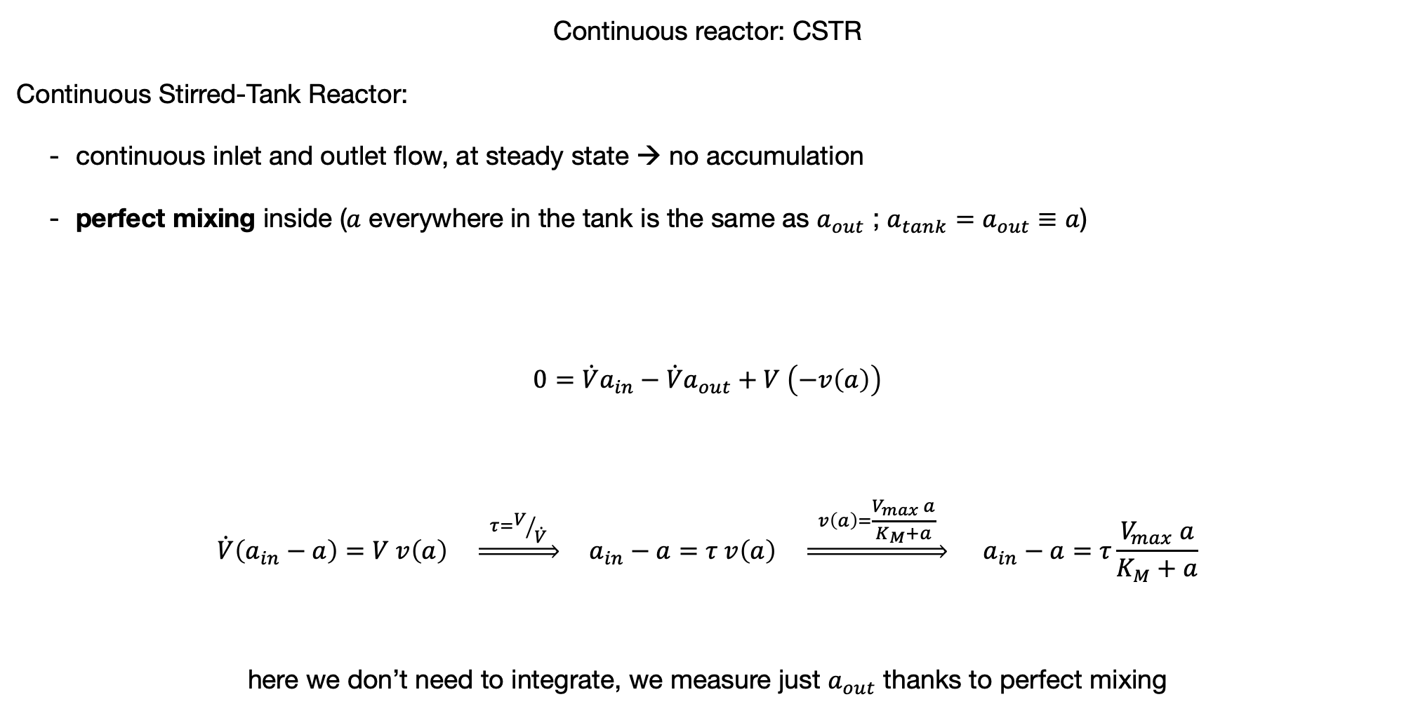
Continuous reactor: CSTR
Continuous Stirred-Tank Reactor:
continuous inlet and outlet flow, at steady state → no accumulation
perfect mixing inside ($a$ everywhere in the tank is the same as $a_{out}$ ; $a_{tank}=a_{out}≡a$)
$$0=\dot{V}a_{in}−\dot{V}a_{out}+V \left(−v\left(a\right)\right)$$
$$\dot{V}\left(a_{in}−a\right)=V v\left(a\right) \underset{⇒}{ τ=V/{\dot{V}} } a_{in}−a=τ v\left(a\right) \underset{⇒}{ v\left(a\right)=\frac{V_{max} a}{K_{M}+a} } a_{in}−a=τ\frac{V_{max} a}{K_{M}+a}$$
here we don’t need to integrate, we measure just $a_{out}$ thanks to perfect mixing

Slide 6
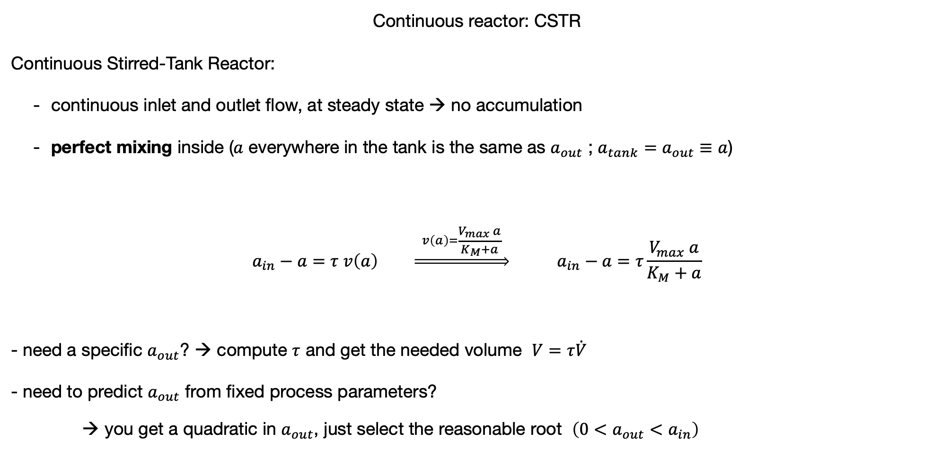
Continuous reactor: CSTR
Continuous Stirred-Tank Reactor:
continuous inlet and outlet flow, at steady state → no accumulation
perfect mixing inside ($a$ everywhere in the tank is the same as $a_{out}$ ; $a_{tank}=a_{out}≡a$)
$$a_{in}−a=τ v\left(a\right) \underset{⇒}{ v\left(a\right)=\frac{V_{max} a}{K_{M}+a} } a_{in}−a=τ\frac{V_{max} a}{K_{M}+a}$$
- need a specific $a_{out}$? → compute $τ$ and get the needed volume $V=τ\dot{V}$
- need to predict $a_{out}$ from fixed process parameters?
you get a quadratic in $a_{out}$, just select the reasonable root $\left({0<a_{out}<a}_{in}\right)$

Slide 7
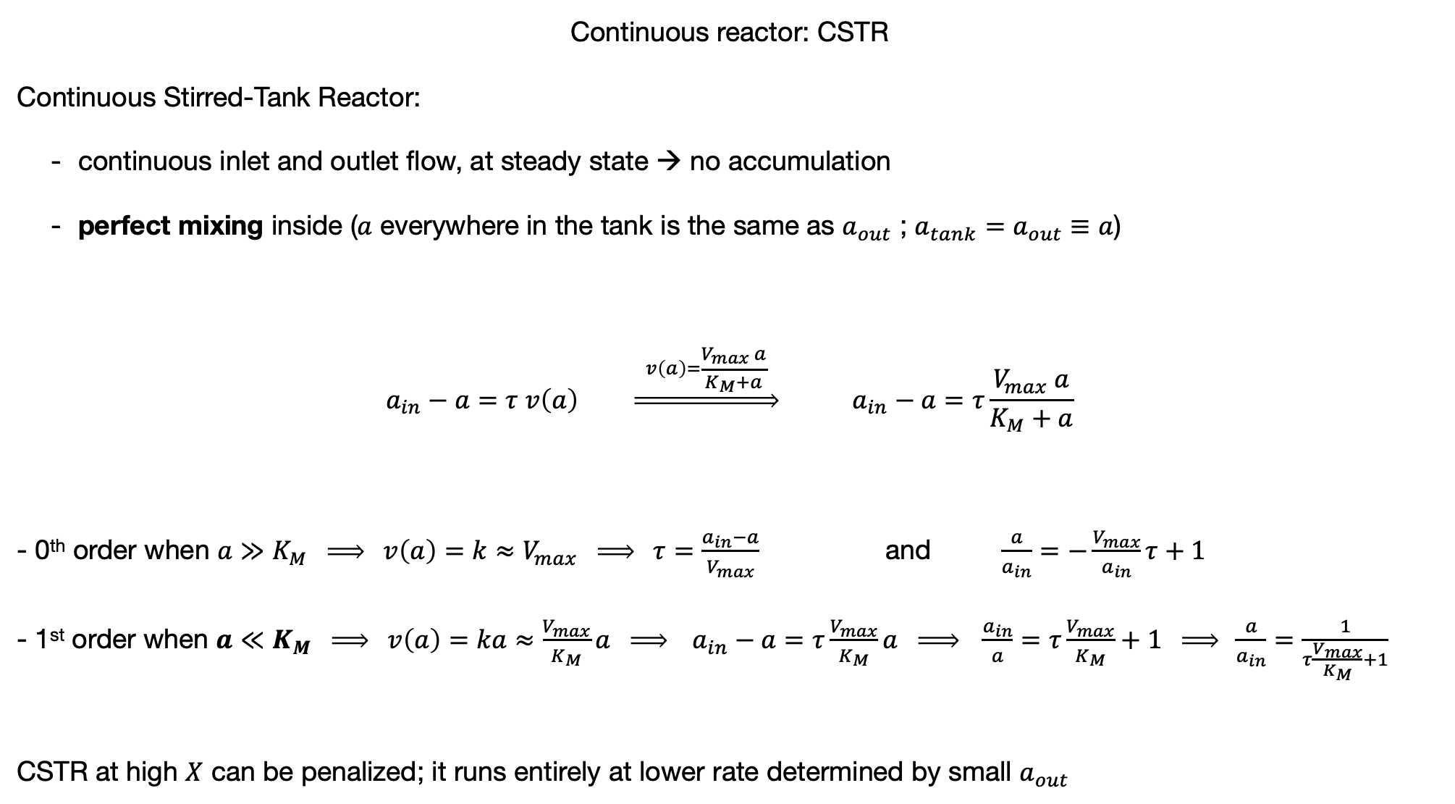
Continuous reactor: CSTR
Continuous Stirred-Tank Reactor:
continuous inlet and outlet flow, at steady state → no accumulation
perfect mixing inside ($a$ everywhere in the tank is the same as $a_{out}$ ; $a_{tank}=a_{out}≡a$)
$$a_{in}−a=τ v\left(a\right) \underset{⇒}{ v\left(a\right)=\frac{V_{max} a}{K_{M}+a} } a_{in}−a=τ\frac{V_{max} a}{K_{M}+a}$$ - 0th order when $a≫K_{M} \underset{⇒}{ } v\left(a\right)=k≈V_{max} \underset{⇒}{ } τ=\frac{a_{in}−a}{V_{max}}$ and $\frac{a}{a_{in}}=−\frac{V_{max}}{a_{in}}τ+1$ - 1st order when $a≪K_{M} \underset{⇒}{ } v\left(a\right)=ka≈\frac{V_{max}}{K_{M}}a \underset{⇒}{ } a_{in}−a=τ\frac{V_{max}}{K_{M}}a \underset{⇒}{ } \frac{a_{in}}{a}=τ\frac{V_{max}}{K_{M}}+1 \underset{⇒}{ } \frac{a}{a_{in}}=\frac{1}{τ\frac{V_{max}}{K_{M}}+1}$
CSTR at high $X$ can be penalized; it runs entirely at lower rate determined by small $a_{out}$
(rectangular) hyperbolic decay

Slide 8
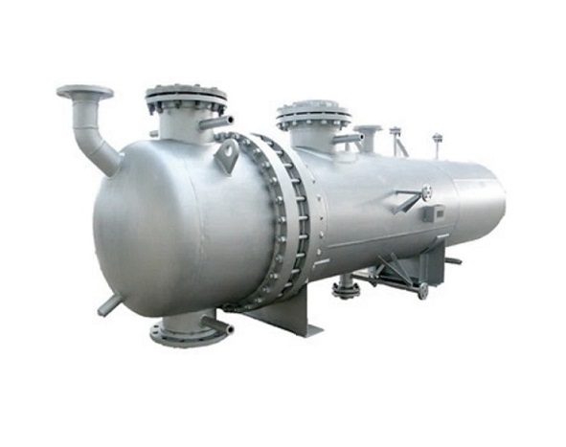
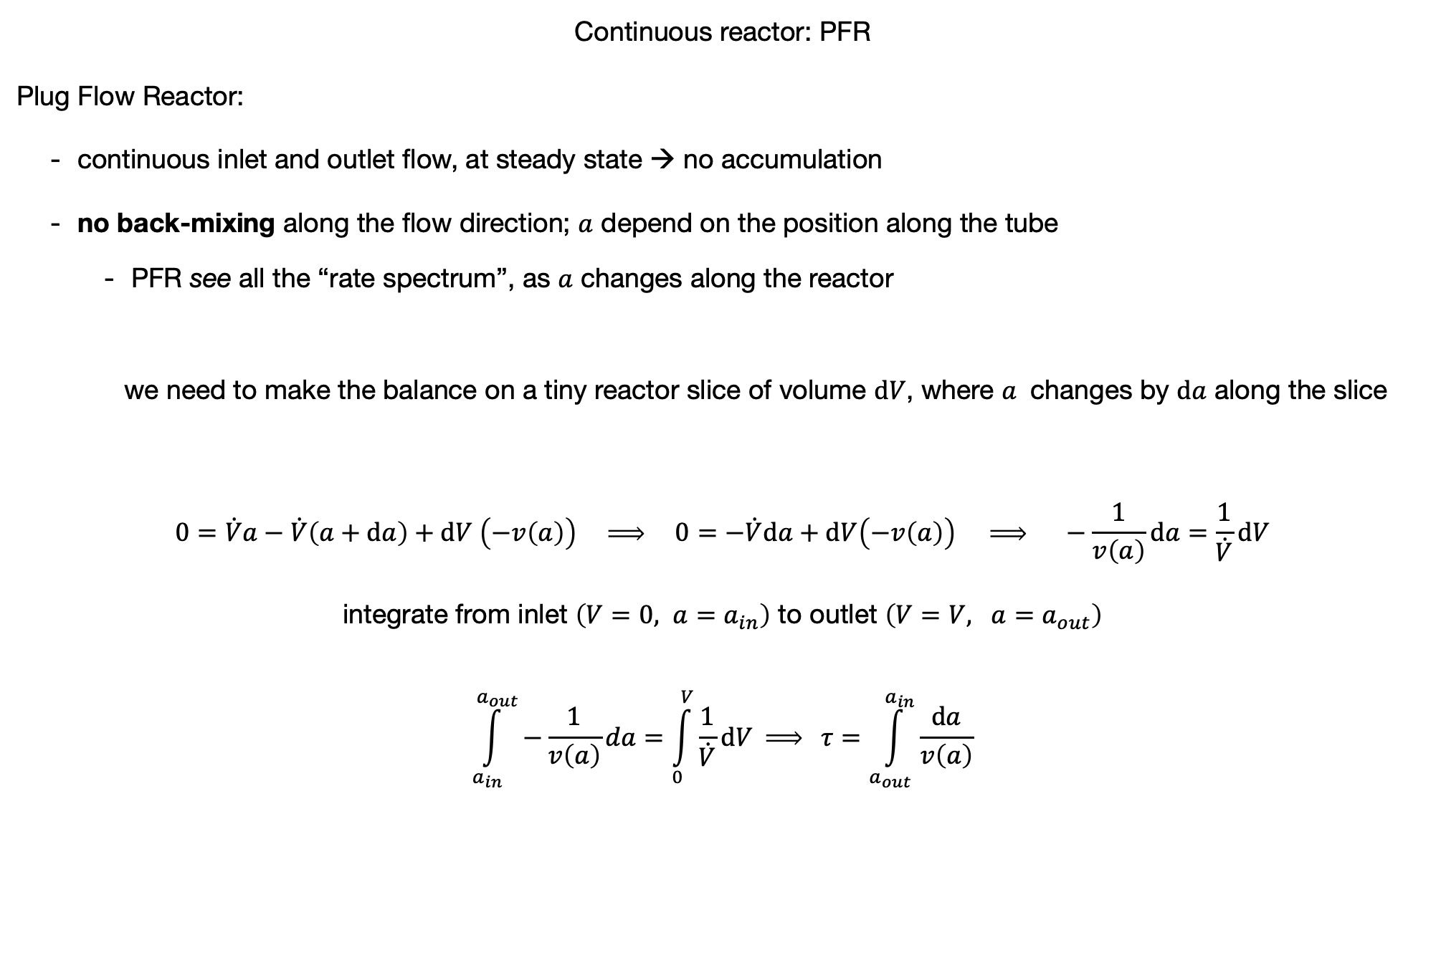
Continuous reactor: PFR
Plug Flow Reactor:
continuous inlet and outlet flow, at steady state → no accumulation
no back-mixing along the flow direction; $a$ depend on the position along the tube
PFR see all the “rate spectrum”, as $a$ changes along the reactor
we need to make the balance on a tiny reactor slice of volume $dV$, where $a$ changes by $da$ along the slice
$$0=\dot{V}a−\dot{V}\left(a+da\right)+dV \left(−v\left(a\right)\right) \underset{⇒}{ } 0=−\dot{V}da+dV\left(−v\left(a\right)\right) \underset{⇒}{ } −\frac{1}{v\left(a\right)}da=\frac{1}{\dot{V}}dV$$
integrate from inlet $\left(V=0, a=a_{in}\right)$ to outlet $\left(V=V, a=a_{out}\right)$ $$\int_{a_{in}}^{a_{out}}{−\frac{1}{v\left(a\right)}da}=\int_{0}^{V}{\frac{1}{\dot{V}}dV }\underset{⇒}{ } τ=\int_{a_{out}}^{a_{in}}{\frac{da}{v\left(a\right)}}$$

Slide 9
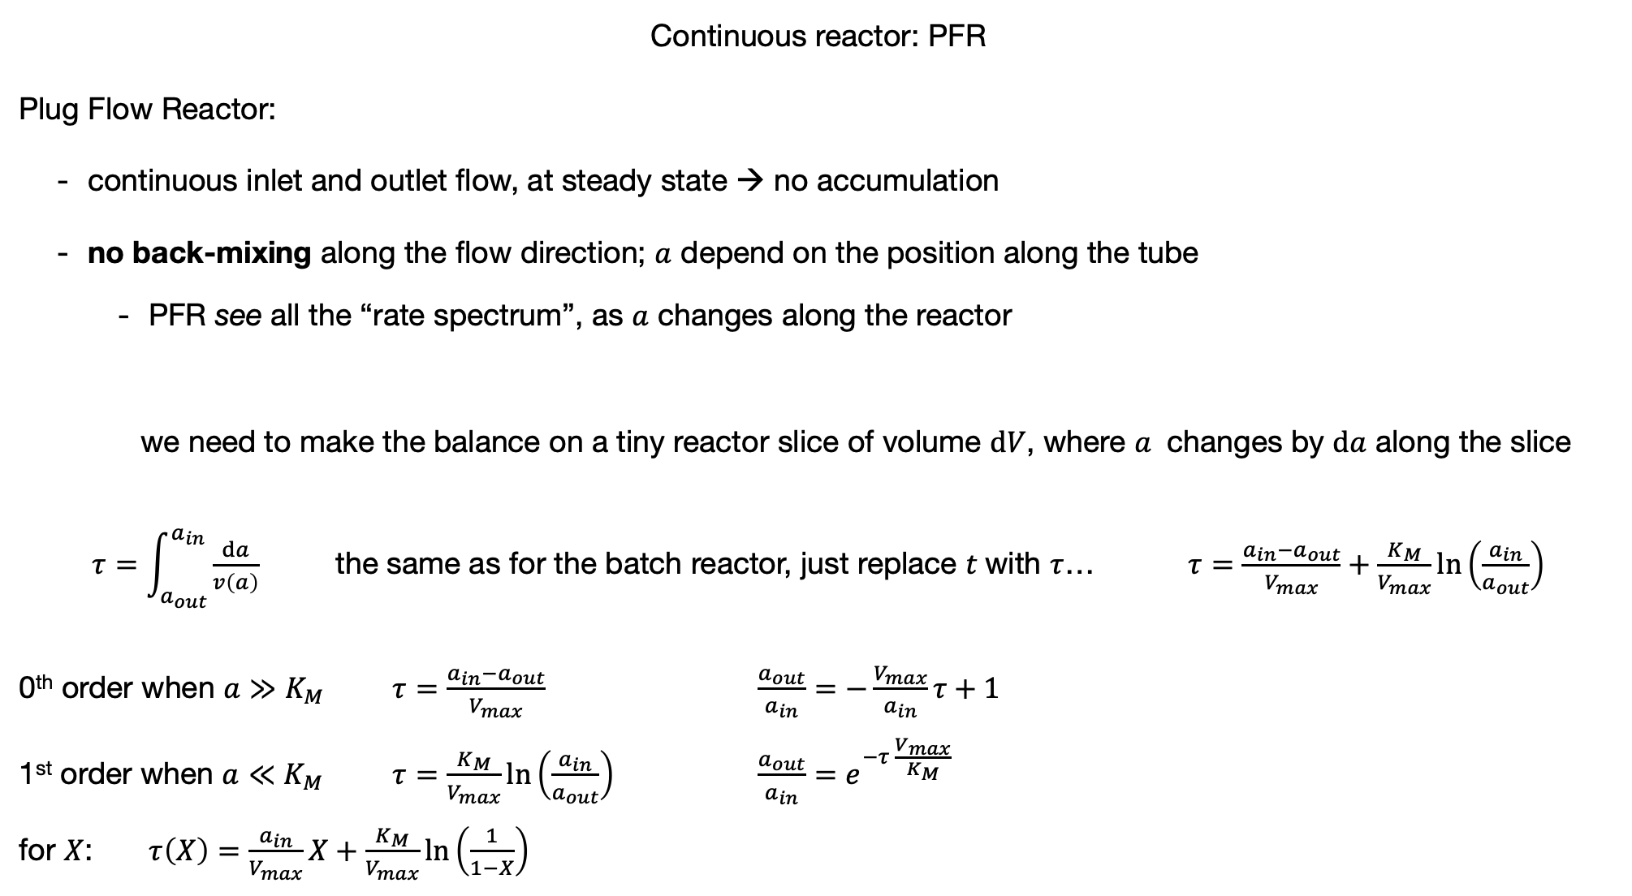
Continuous reactor: PFR
Plug Flow Reactor:
continuous inlet and outlet flow, at steady state → no accumulation
no back-mixing along the flow direction; $a$ depend on the position along the tube
PFR see all the “rate spectrum”, as $a$ changes along the reactor
we need to make the balance on a tiny reactor slice of volume $dV$, where $a$ changes by $da$ along the slice
$τ=\int_{a_{out}}^{a_{in}}{\frac{da}{v\left(a\right)}}$ the same as for the batch reactor, just replace $t$with $τ$… $τ=\frac{a_{in}−a_{out}}{V_{max}}+\frac{K_{M}}{V_{max}}\ln\left(\frac{a_{in}}{a_{out}}\right)$
0th order when $a≫K_{M}$ $τ=\frac{a_{in}−a_{out}}{V_{max}}$ $\frac{a_{out}}{a_{in}}=−\frac{V_{max}}{a_{in}}τ+1$
1st order when $a≪K_{M}$ $τ=\frac{K_{M}}{V_{max}}\ln\left(\frac{a_{in}}{a_{out}}\right)$ $\frac{a_{out}}{a_{in}}=e^{−τ \frac{V_{max}}{K_{M}}}$
for $X$: $τ\left(X\right)=\frac{a_{in}}{V_{max}}X+\frac{K_{M}}{V_{max}}\ln\left(\frac{1}{1−X}\right)$

Slide 10
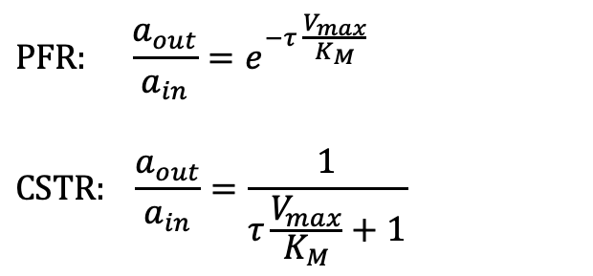
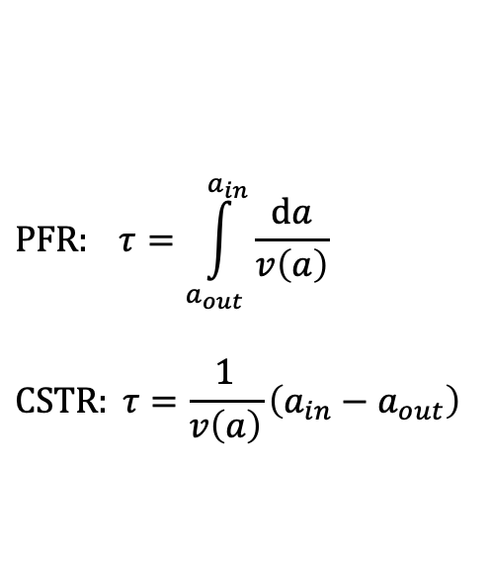
Continuous reactor: PFR vs CSTR, at the “1st order regime”
Levenspiel plot
$$PFR: τ=\int_{a_{out}}^{a_{in}}{\frac{da}{v\left(a\right)}}$$
$$CSTR: τ=\frac{1}{v\left(a\right)}\left(a_{in}−a_{out}\right)$$
$$PFR: \frac{a_{out}}{a_{in}}=e^{−τ \frac{V_{max}}{K_{M}}}$$
$$CSTR: \frac{a_{out}}{a_{in}}=\frac{1}{τ\frac{V_{max}}{K_{M}}+1}$$

Slide 11
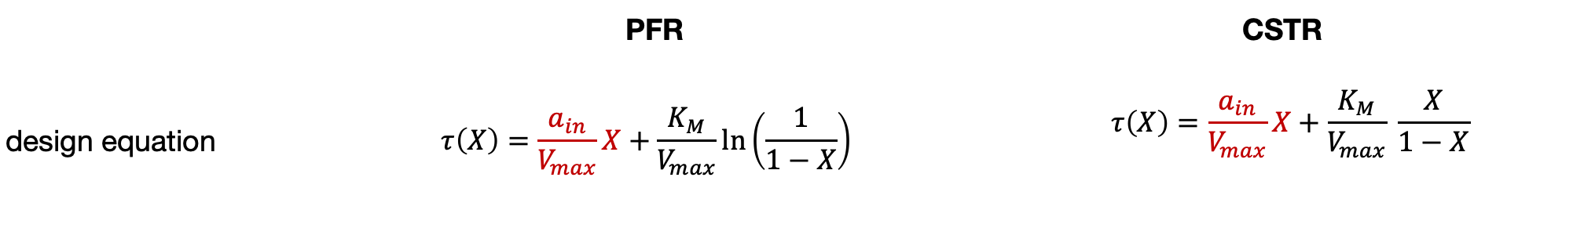
Continuous reactor: PFR vs CSTR, general
 | PFR |  | CSTR
design equation |  | $$τ\left(X\right)=\frac{a_{in}}{V_{max}}X+\frac{K_{M}}{V_{max}}\ln\left(\frac{1}{1−X}\right)$$ |  | $$τ\left(X\right)=\frac{a_{in}}{V_{max}}X+\frac{K_{M}}{V_{max}} \frac{X}{1−X}$$
let’s play with Excel,
also, with staging!

